Slide 1
Office 365 development

Slide 2
Apply Office UI Fabric to Office Add-ins
</>

Slide 3
Agenda
Intro to the Office UI Fabric
Apply the Office UI Fabric
Examples of Office UI Fabric

Slide 4
Developer vision
USERS
DATA
HTML

Slide 5
1
Intro to the Office UI Fabric

Slide 6
What is the Office UI Fabric?
Intro to the Office UI Fabric
Office UI Fabric is a responsive, mobile-first, front-end framework that you can use to apply the Office Design Language to your web experiences.
Built by Microsoft
All about styling instead of JavaScript
Integrates with other frameworks
Language support
Notes:
An App for Office can be seen as a Web page loaded inside an Office Application. In some cases it will appear embedded inline within the document. In other cases it might appear as a task pane or within a message in Outlook. Note that the architecture for Apps for Office has been designed to work in both Office Applications and Office Web Applications.
WEF and Apps for Office allow Office applications to be extended in such as way so that they can leverage Web technologies such as HTML 5 and CSS for rendering user interface as well as JavaScript and jQuery to add behavior. When you write the JavaScript code for an App for Office, you can call REST APIs such as those added to SharePoint 2013 to retrieve and update data from across network.

Slide 7
The Code
Office UI Fabric Developer Site
http://dev.office.com/fabric
Get Started
http://dev.office.com/fabric/getting-started
OpenSource GitHub Repository
https://github.com/OfficeDev/Office-UI-Fabric

Slide 8
2
Apply the Office UI Fabric

Slide 9
Ways to obtain the Office UI Fabric
Reference the Fabric CDN <link rel="stylesheet" href="http://appsforoffice.microsoft.com/fabric/1.0/fabric.min.css"> <link rel="stylesheet" href="http://appsforoffice.microsoft.com/fabric/1.0/fabric.components.min.css">
Use Nuget to install in a project PM>Install-Package OfficeUIFabric
Download and install in a project
https://github.com/OfficeDev/Office-UI-Fabric/releases

Slide 10
Office UI Fabric Components
Fabric's components make up the building blocks of your UI and are meant to be consumed as CSS applied to your markup.
All JavaScript is presentational to explain behavior.
Download the components from the GitHub repository
https://github.com/OfficeDev/Office-UI-Fabric/tree/master/src/components

Slide 11
Implementing Office UI Fabric Components
Download the component
SearchBox component example - https://github.com/OfficeDev/Office-UI-Fabric/tree/master/src/components/SearchBox
Add the component reference to your code
<script src="SearchBox/JQuery.SearchBox.js"></script>
Initialize the component upon page load
$(".ms-SearchBox").SearchBox()
Add the component markup
<div class="ms-SearchBox"> <input class="ms-SearchBox-field" type="text"> <label class="ms-SearchBox-label"> <i class="ms-SearchBox-icon ms-Icon ms-Icon--search"></i>Search </label> <button class="ms-SearchBox-closeButton"><i class="ms-Icon ms-Icon--x"></i> </button> </div>
Notes:
This example uses the SearchBox component

Slide 12
3
Examples of Office UI Fabric

Slide 13
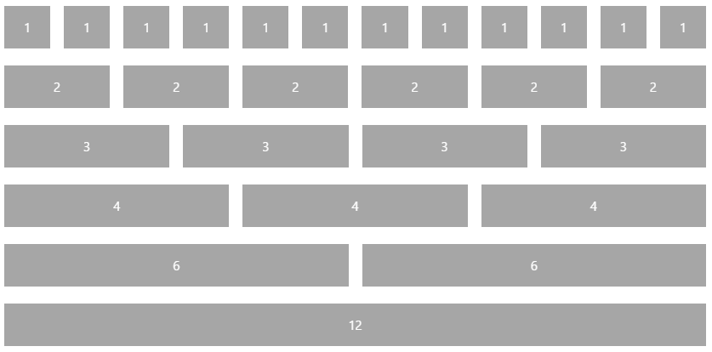
Responsive Grid
<div class="ms-Grid">
<div class="ms-Grid-row">
<div class="ms-Grid-col ms-u-sm6 ms-u-md4 ms-u-lg2">First</div>
<div class="ms-Grid-col ms-u-sm6 ms-u-md8 ms-u-lg10">Second</div>
</div>
</div>

Slide 14
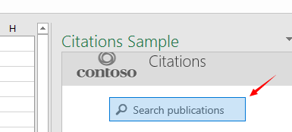
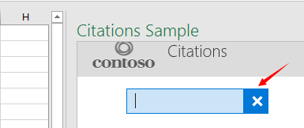
SearchBox
<div class="ms-SearchBox">
<label class="ms-SearchBox-label">
<i class="ms-SearchBox-icon ms-Icon ms-Icon--search"></i>
Search publications
</label>
<input class="ms-SearchBox-field">
<button class="ms-SearchBox-closeButton"><i class="ms-Icon ms-Icon--x"></i></button>
</div>

Slide 15
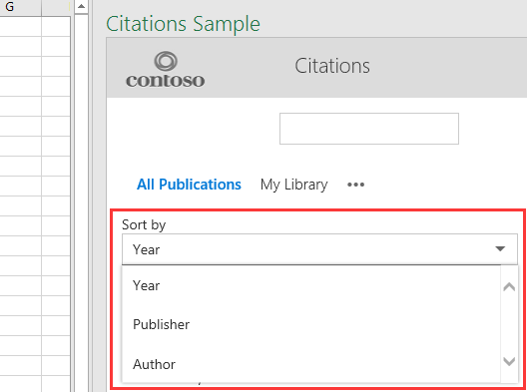
Dropdown
<div class="ms-Dropdown" tabindex="0" style="width:80%">
<i class="ms-Dropdown-caretDown ms-Icon ms-Icon--caretDown"></i>
<select class="ms-Dropdown-select">
<option>Year</option>
<option>Publisher</option>
<option>Author</option>
</select>
</div>

Slide 16
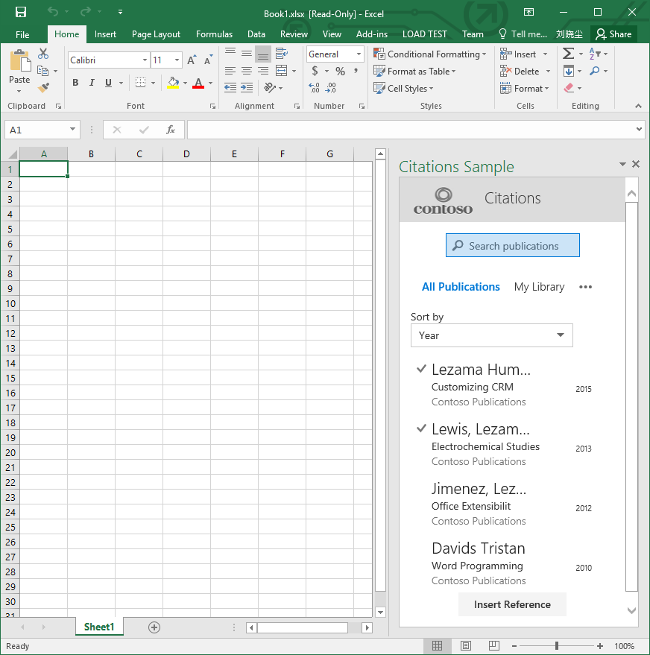
Office UI Fabric Demo

Slide 17
Summary
Intro to the Office UI Fabric
Apply the Office UI Fabric
Examples of Office UI Fabric

Slide 18
Further reading…
Getting Started with Office add-ins
Office add-in Code Samples
Office add-in Training videos & hands on labs
Office add-in Snack videos
Office add-in documentation

Slide 19
Developer Program launch
1 YEAR FREE
Email Newsletters
Free Developer Subscription
Free Training
Free Tools
Webinars
http://dev.office.com/devprogram

Slide 20
Engage

